Slide 1

Oreoluwa Seweje x BrainStation
April 2024
Where it’s needed
Loan Approval:
Individuals applying for any type of loan—be it a mortgage, personal loan, auto loan, or business loan
Apartment Rental:
Landlords and property management companies check potential tenants' credit histories as part of the rental application process.
Insurance Premiums:
Insurance companies may use credit history to determine insurance premiums for products such as auto or homeowners insurance.
Credit Card Application:
Credit card issuers review an applicant's credit history to decide on application approval and to determine credit limit and interest rate.
Notes:
Good afternoon all My name is Oreoluwa Seweje and I’m here to present “A Credit History Alternative”. So credit history especially in this side of the world is basically a measure of trust worthiness. if

Slide 2
Where it’s needed
Loan Approval:
Individuals applying for any type of loan—be it a mortgage, personal loan, auto loan, or business loan
Apartment Rental:
Landlords and property management companies check potential tenants' credit histories as part of the rental application process.
Insurance Premiums:
Insurance companies may use credit history to determine insurance premiums for products such as auto or homeowners insurance.
Credit Card Application:
Credit card issuers review an applicant's credit history to decide on application approval and to determine credit limit and interest rate.
Oreoluwa Seweje x BrainStation
April 2024
Young Age or New to Credit:
Individuals who are young or have recently become eligible to apply for credit may not have had the opportunity to build a credit history. This includes young adults, students, or recent immigrants who haven't used any credit products in their name.
Cash-based Lifestyle:
Some people prefer to live a cash-based lifestyle, paying for everything with cash or debit cards and avoiding borrowing or credit products altogether. While this can be a financially sound way to live, it does not contribute to building a credit history.
Lack of Borrowing History:
To have a credit history, an individual must have had some form of credit, such as a loan or credit card, reported to the credit bureaus. If someone has never borrowed money or had a credit account, they won't have a credit history
Recent Immigration:
Immigrants may have had a substantial credit history in their home country, but when they move to a new country, they often have to start from scratch. Credit histories do not transfer across borders
Notes:
An individual needs a loan from the bank, or property managers need to be sure you can pay your rent, or insurance firms and for credit card applications.. They all require some credit score which is based off your credit history. But what if you are a

Slide 3

Loan Approval:
Individuals applying for any type of loan—be it a mortgage, personal loan, auto loan, or business loan
Apartment Rental:
Landlords and property management companies check potential tenants' credit histories as part of the rental application process.
Insurance Premiums:
Insurance companies may use credit history to determine insurance premiums for products such as auto or homeowners insurance.
Credit Card Application:
Credit card issuers review an applicant's credit history to decide on application approval and to determine credit limit and interest rate.
Young Age or New to Credit:
Individuals who are young or have recently become eligible to apply for credit may not have had the opportunity to build a credit history. This includes young adults, students, or recent immigrants who haven't used any credit products in their name.
Cash-based Lifestyle:
Some people prefer to live a cash-based lifestyle, paying for everything with cash or debit cards and avoiding borrowing or credit products altogether. While this can be a financially sound way to live, it does not contribute to building a credit history.
Lack of Borrowing History:
To have a credit history, an individual must have had some form of credit, such as a loan or credit card, reported to the credit bureaus. If someone has never borrowed money or had a credit account, they won't have a credit history
Recent Immigration:
Immigrants may have had a substantial credit history in their home country, but when they move to a new country, they often have to start from scratch. Credit histories do not transfer across borders
Create a Machine-learning model that takes financial information to make a prediction
Notes:
Recent immigrant, Or new to credit, or you don’t have a credit history for whatever reason… This is where an alternative measure of trustworthiness can come into play. Given the client has certain financial information we should be able to determine if they are trustworthy or not. As with everything these days the solution is to

Slide 4
Create a Machine-learning model that takes financial information to make a prediction
Notes:
Create a machine-learning model that predicts if a user is likely to default on their loan request. Some solutions exist currently but they have a stability issue. Mention that the financial information would be determined by the service providers and can be different for property managers, banks, insurance companies e.t.c. Obviously, other solutions exist but this solution aims to tackle things in a different way before that, let’s talk dataset and some challenges.

Slide 5
APPROACH
DATA
DATA
The data is obtained from an ongoing Kaggle Competition “Home Credit Risk Stability”
1,000,000 rows of data and 500 total columns
Highly Imbalanced dataset with a 97% no-default rate.
Numeric values have a wide variance throughout the dataset.

Slide 6
DATA
Obtained from an ongoing Kaggle Competition “Home Credit Risk Stability”
1,000,000 rows of data and 500 total columns
Highly Imbalanced dataset with a 97% no-default rate.
Numeric values have a wide variance throughout the dataset.
Sparse Data: Less than 10% of columns with full information.
Notes:
Read off important variables. And recap, So lot’s of data that is highly imbalanced and potentially difficult to scale. So How do we tackle these issues?

Slide 7

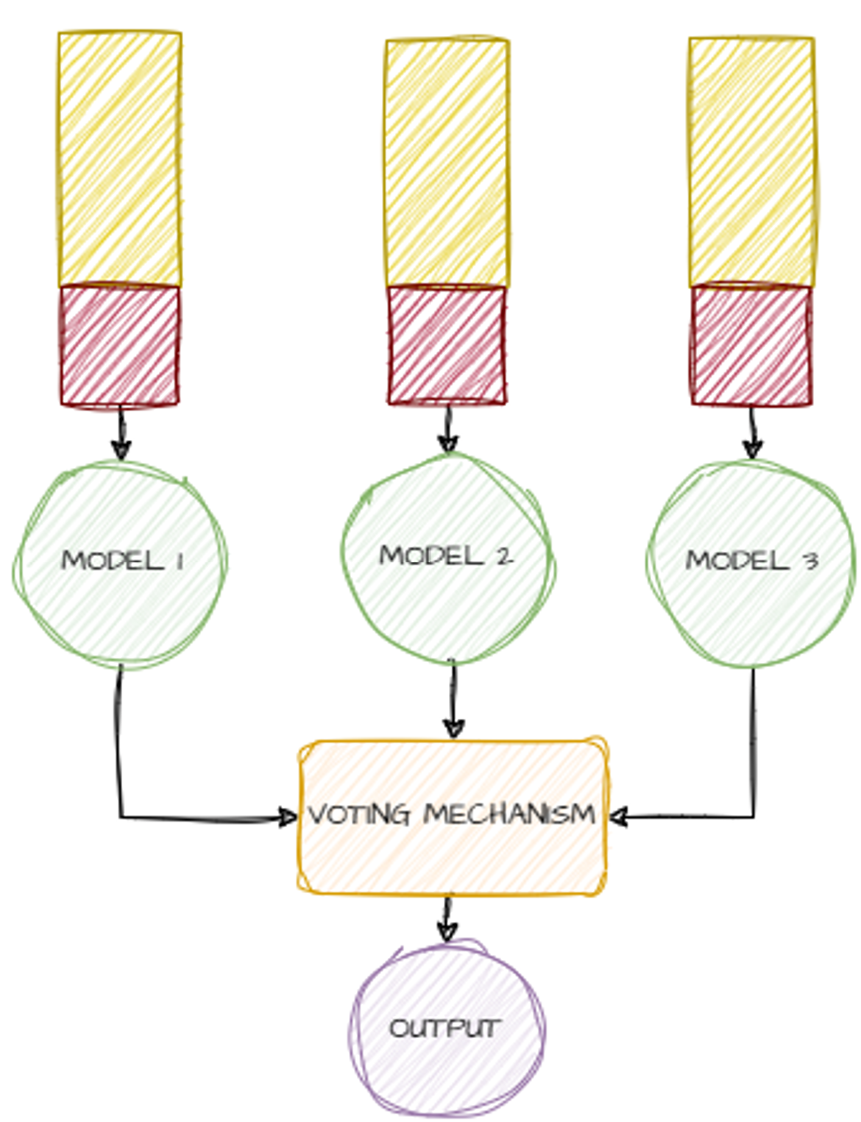
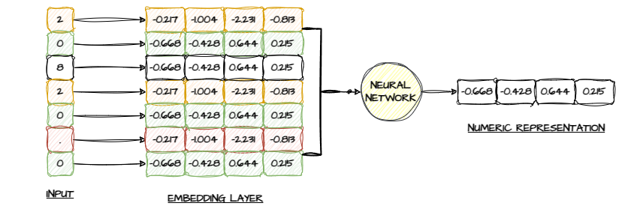
Notes:
We kill two birds with one stone by moving from a one-model approach to an Ensemble-model approach. This allows us to split the majority class into different datasets and keep the same minority set for all. We train each model separately or finetune the new model based on the previous models. At the end, we use the average of the trained models to make a final decision. So splits done.. How do we handle numeric values?

Slide 8
maxdpdinstldate_3546855D is empty, maxdpdinstlnum_3546846P is empty, maxdpdlast12m_727P is <|NUM|>, maxdpdlast24m_143P is <|NUM|>, maxdpdlast3m_392P is <|NUM|>, maxdpdlast6m_474P is <|NUM|>, maxdpdlast9m_1059P is <|NUM|>, maxdpdtolerance_374P is <|NUM|>, maxinstallast24m_3658928A is <|AMOUNT|>, riskassesment_940T is empty, secondquarter_766L is <|NUM|>, thirdquarter_1082L is <|NUM|>, date_decision is <|DATE|>
Notes:
We don’t implicitly scale numeric values. Instead, we create a layer that learns patterns and provides numeric representation. Convolutional modules play a key part here. Next how do we handle the sparsity in a meaning full way

Slide 9
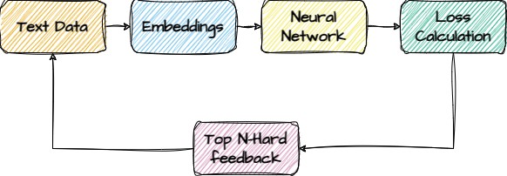
maxdpdinstldate_3546855D is empty, maxdpdinstlnum_3546846P is empty, maxdpdlast12m_727P is <|NUM|>, maxdpdlast24m_143P is <|NUM|>, maxdpdlast3m_392P is <|NUM|>, maxdpdlast6m_474P is <|NUM|>, maxdpdlast9m_1059P is <|NUM|>, maxdpdtolerance_374P is <|NUM|>, maxinstallast24m_3658928A is <|AMOUNT|>, riskassesment_940T is empty, secondquarter_766L is <|NUM|>, thirdquarter_1082L is <|NUM|>, date_decision is <|DATE|>
THE NETWORK
Notes:
We convert the input to text. The right shows a truncated example of a row converted to text. Things without numbers are tagged as empty, and actual values have tags that represent them. Of course for this we had to create our own vocabulary and encoder.. More details about that can be found in the Github repository.

Slide 10
THE NETWORK
The overall flow of the algorithm
Notes:
The network in itself follows basic principles. The only significant difference is in the Transformer architecture

Slide 11
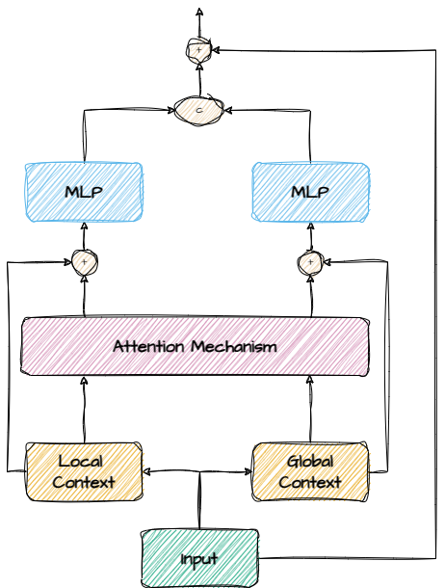
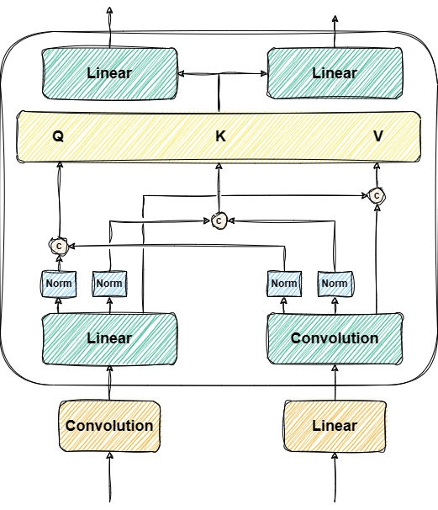
Notes:
Main difference is we have a pre-step that looks to combine local and global information before the QKV. The more technical info on how this is implemented and other training ideas can be found in the github repo

Slide 12
APPROACH
PERFORMANCE
PERFORMANCE
The data is obtained from an ongoing Kaggle Competition “Home Credit Risk Stability”
1,000,000 rows of data and 500 total columns
Highly Imbalanced dataset with a 97% no-default rate.
Numeric values have a wide variance throughout the dataset.
77 % overall for predicting a default or no-default outcome
65 % precision and 72% recall on the given test set*.

Slide 13
PERFORMANCE
77 % overall for predicting a default or no-default outcome
65 % precision and 72% recall on the given test set*.
*Yet to test on the Kaggle submission board
Not Enough Computing Power. Hinders expressiveness
Parameter Tuning is not done at this stage. Simply baselines from research papers
Time
Notes:
The performance here is from training one stack of the ensemble model and not representative of the final numbers.

Slide 14
Not Enough Computing Power. Hinders expressiveness
Parameter Tuning is not done at this stage. Simply baselines from research papers
Time
Notes:
Recent immigrant, Or new to credit, or you don’t have a credit history for whatever reason… This is where an alternative measure of trustworthiness can come into play. Given the client has certain financial information we should be able to determine if they are trustworthy or not. As with everything these days the solution is to

Slide 15

THE END ..

